Slide 1

MNIST from Scratch

Slide 2
Reference
Youtube
Code

Slide 3


Slide 4
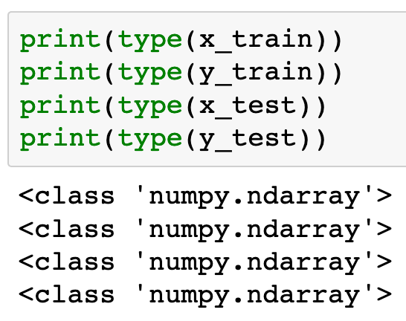

Slide 5
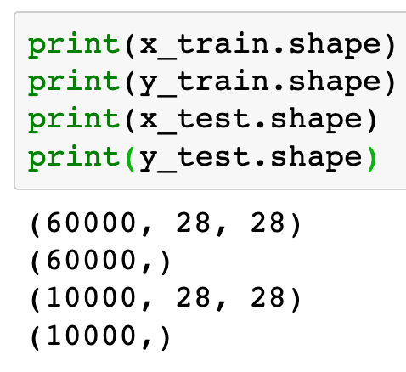

Slide 6
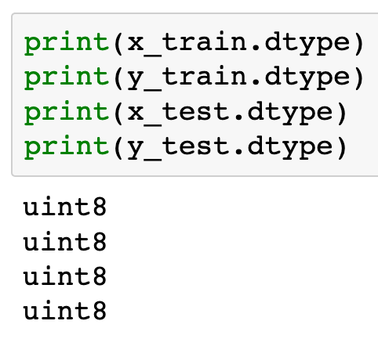

Slide 7
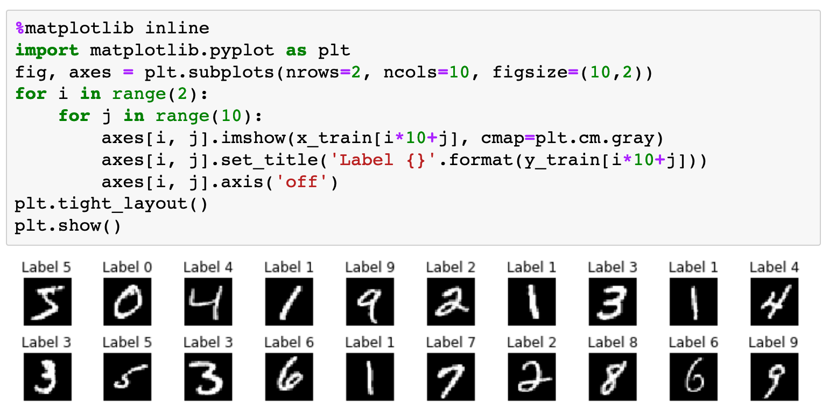

Slide 8
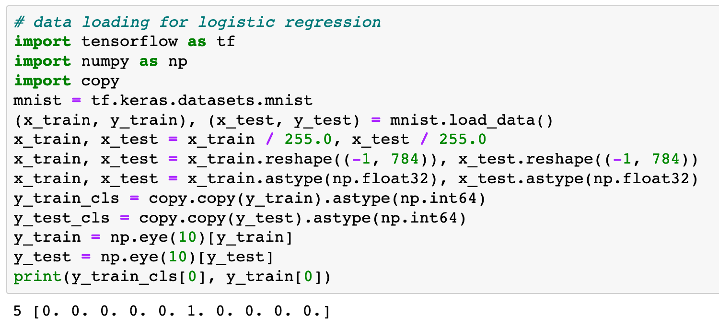

Slide 9
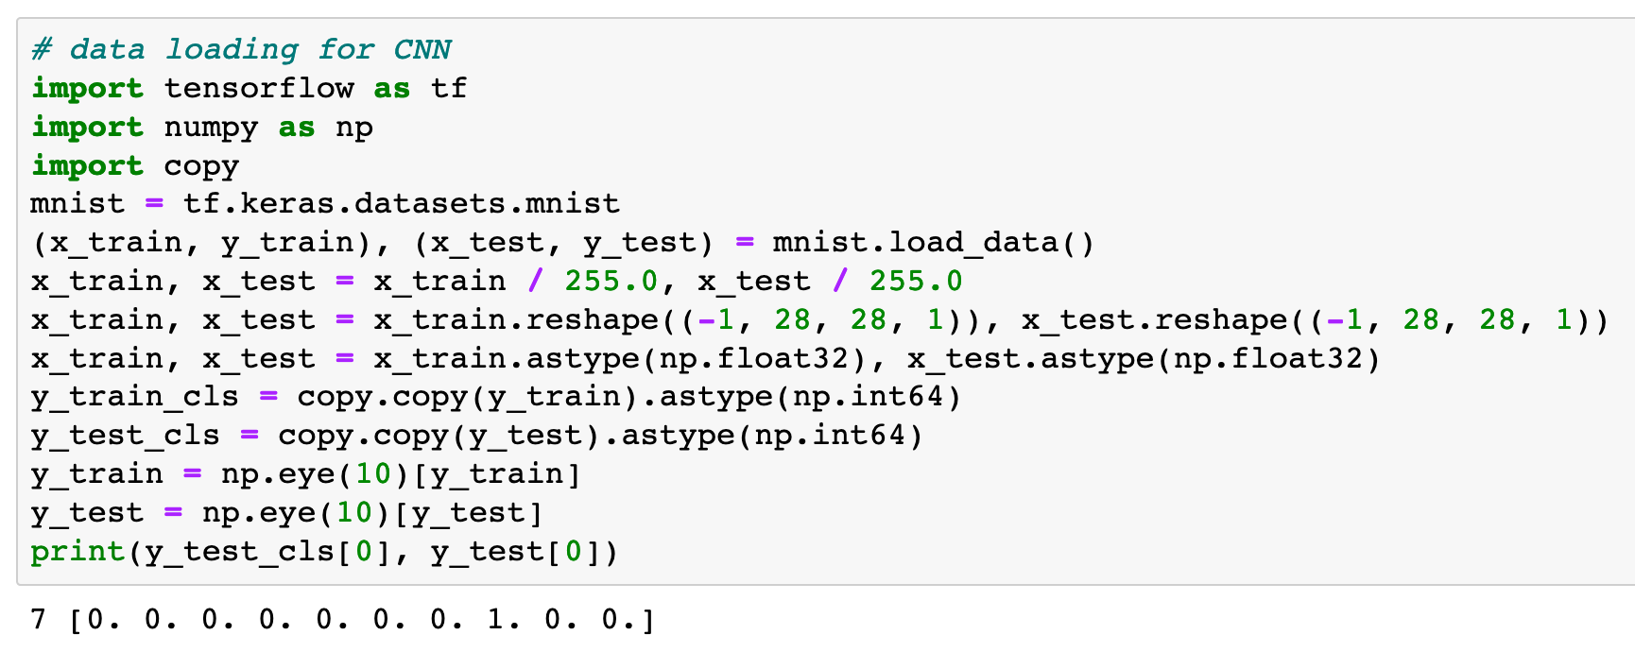

Slide 10
Now
Let’s Play with Code

